Slide 1


A community effort to collect a curated set of analysis pipelines built using Nextflow.

Slide 2




nf-core in numbers
77
19
Genomics
3
1
Transcriptomics
Metabolomics
✅ Released pipelines
2
9
(Bio)imaging
35
Metagenomics
🔧 Under development
N.B.: category numbers from Feb. 2025!
Notes:
As youcan see, many different pipelines so I’m not going to try to tell you much about any particular one, but rather try to convince why you should take the time to explore and try out the pipelines.

Slide 3
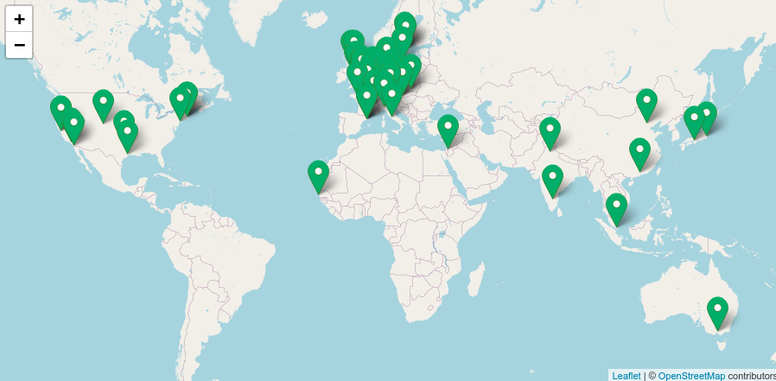

nf-core in numbers
>11K
1.7K
👩‍💻 Slack Members
👩‍💻 GitHub Organisation Members
Notes:
And you wouldn’t be the first..

Slide 4






nf-core principles
Principles that guide the nf-core community
Cooperation
Standards
Collaboration
Develop with the community
Use a common template
No duplicate pipelines within nf-core
Helper Tools
Compatibility
Components
Tools built for everyone
Tools work for any Nextflow pipeline
Collaborate on component-level

Slide 5






nf-core components
Pick and choose which component you need
Pipelines
Subworkflows
Modules
>95 pipelines and a base template
>55 subworkflows
>1150 modules
Linting
Schema
Tooling
Choose conventions to test for consistency
Validation, channels and user interface
Development and deployment

Slide 6

nf-core/tools
Command line tools to help you build your pipeline with ease
Pipelines
Subworkflows
Modules
Create from template, sync to get updates
Create, install and update
Create, install, update, patch, test
Schema
Linting
Download
Build your pipeline schema with a GUI
Test nf-core standards and best practices
Fetch with singularity images for offline use

Slide 7

Why use ?
For users
Notes:
So let’s first start with users. Why should you use nf-core pipelines over other existing pipelines and/or making your own?

Slide 8
Finding Software
What does it do?
Does it work?
Is it easy to use?
Will I understand the output?
Will it be fast enough?
Is it easy to install?

Slide 9
Finding Software
What does it do?
Does it work?
Is it easy to use?
Will I understand the output?
Will it be fast enough?
Is it easy to install?

Slide 10
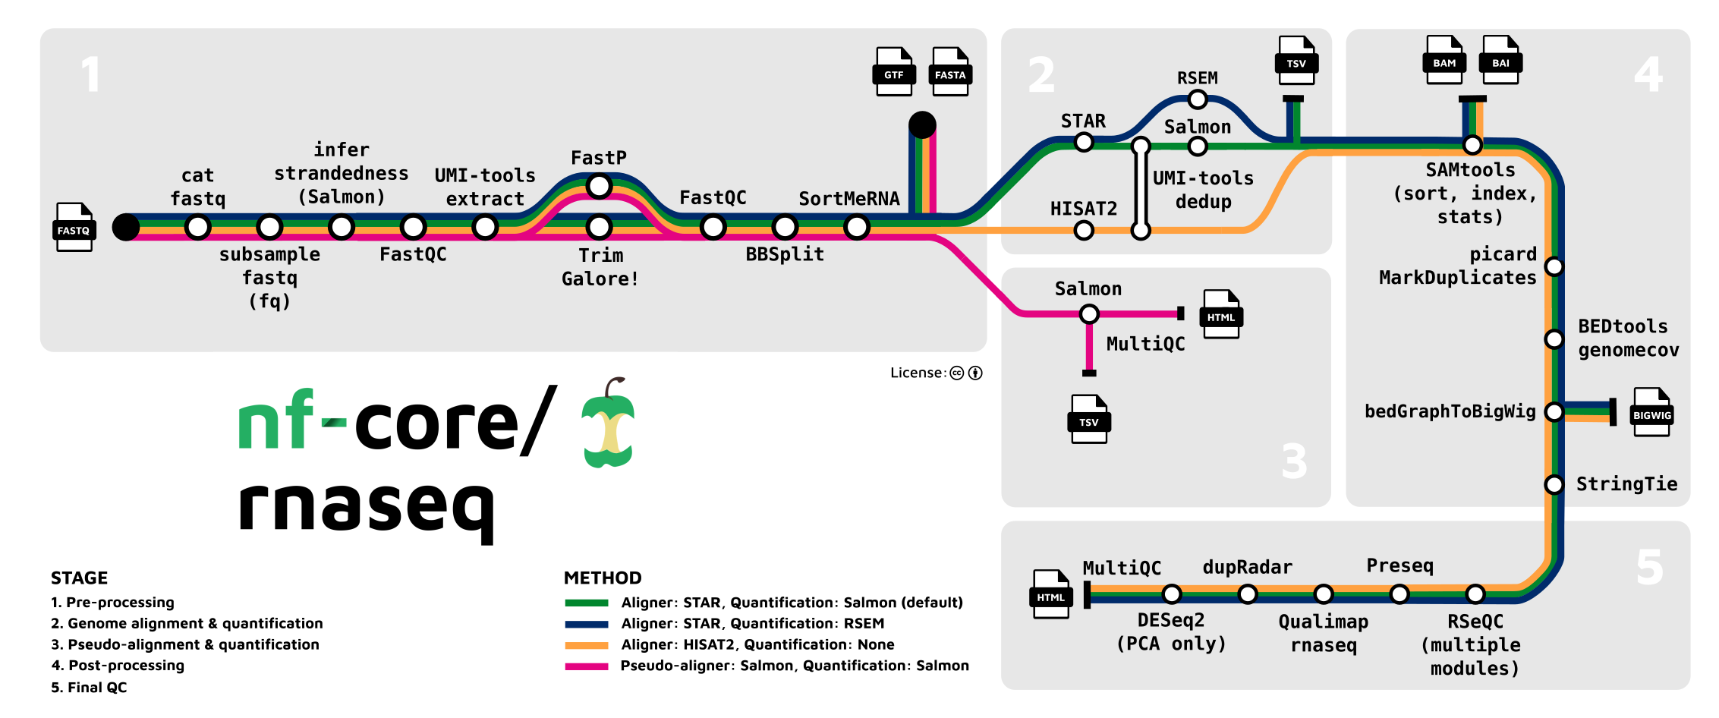

Documentation
(Overview)
High-quality documentation required by nf-core guidelines
Easy to understand what and how a pipeline works

Slide 11
Finding Software
What does it do?
Does it work?
Is it easy to use?
Will I understand the output?
Will it be fast enough?
Is it easy to install?

Slide 12
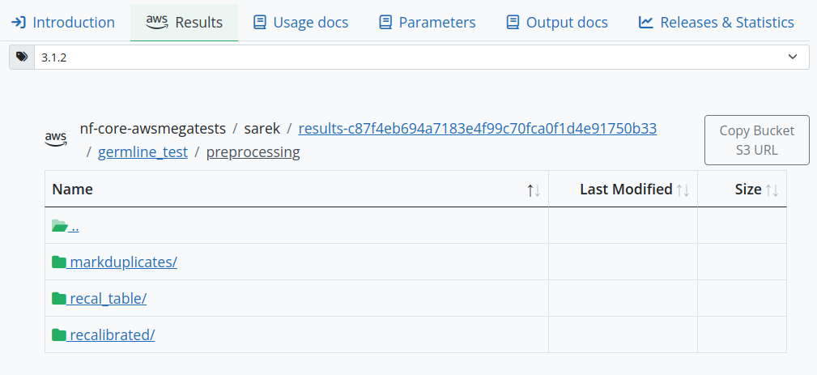
Documentation (Examples)
Example ‘real life’ output automatically and tested generated on every release

Slide 13
Finding Software
What does it do?
Does it work?
Is it easy to use?
Will I understand the output?
Will it be fast enough?
Is it easy to install?

Slide 14
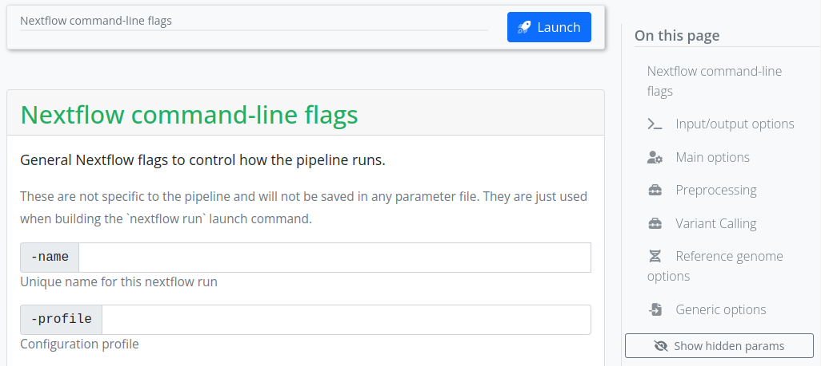
Consistent (Execution)
$ nextflow run \ > nf-core/mag -r 2.3.0 \ > -profile docker \ > --input \ > --outdir
$ nextflow run \ > nf-core/funcscan -r 1.0.1 \ > -profile docker \ > --input \ > --outdir

Slide 15
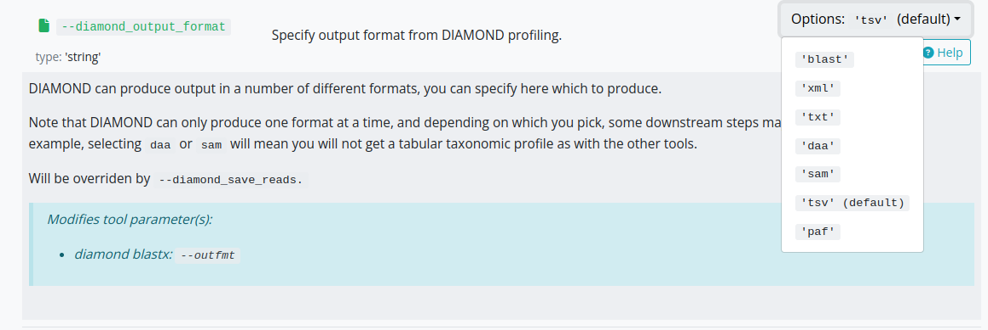
Documentation
(Input)
Rich documentation & validation of inputs
Auto-generation of commands & configuration files.
Consistent interface across all pipelines for familiarity

Slide 16
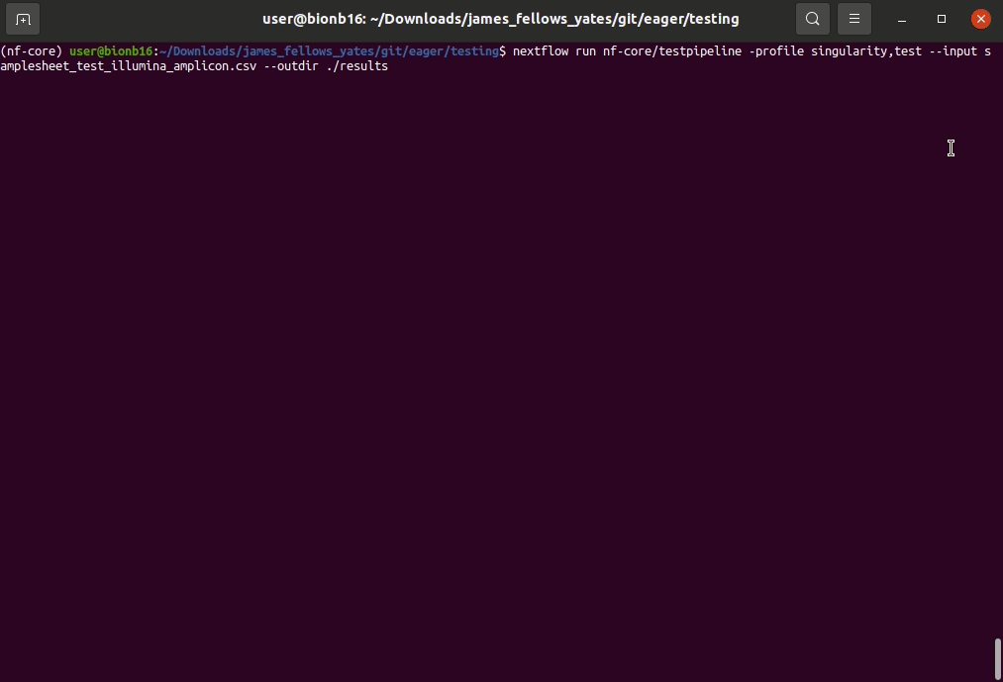
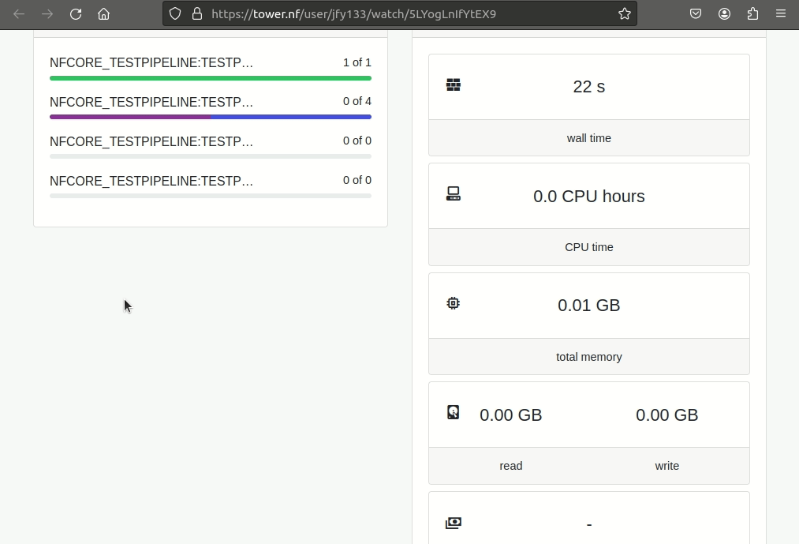
Provenance
Real time monitoring of runs both in-console (and online - optional)
gif from tower.nf by Seqera labs

Slide 17
Finding Software
What does it do?
Does it work?
Is it easy to use?
Will I understand the output?
Will it be fast enough?
Is it easy to install?

Slide 18
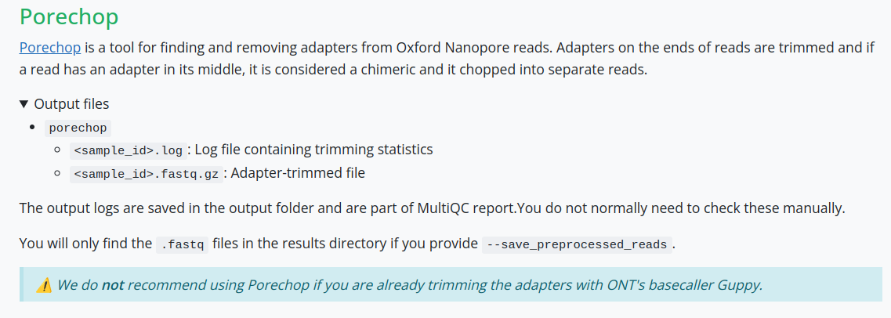

Documentation (Output)
Descriptions of every output file
Additional guidance on interpretation of output
(not all pipelines)

Slide 19
Finding Software
What does it do?
Does it work?
Is it easy to use?
Will I understand the output?
Will it be fast enough?
Is it easy to install?

Slide 20
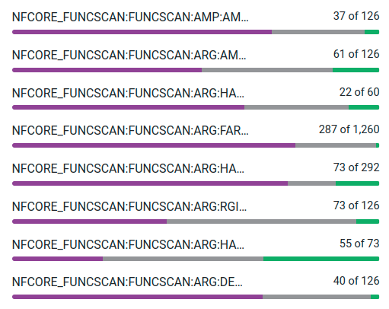

Scalable
Inherent scalability of Nextflow means nf-core pipelines cope with 10s-1,000,000s of jobs/files
Output evaluation also scalable with MultiQC

Slide 21










Portable
Many schedulers supported by Nextflow
$ nextflow run nf-core/rnaseq -profile eva <...>
$ nextflow run nf-core/rnaseq -profile mpcdf,raven <...>
$ nextflow run nf-core/rnaseq -profile binac <...>
$ nextflow run nf-core/rnaseq -profile awsbatch <...>
Many institutional clusters/HPC already supported by
& more
as well as the cloud

Slide 22
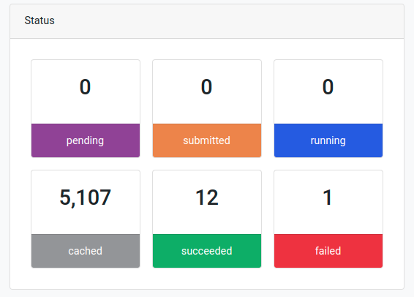
Fault Tolerant
Automatic retry functionality
Resume functionality (-resume)
Ignore error functionality
Screenshot from tower.nf by Seqera labs

Slide 23
Finding Software
What does it do?
Does it work?
Is it easy to use?
Will I understand the output?
Will it be fast enough?
Is it easy to install?

Slide 24









Installation
OR
$ conda create -n nextflow -c bioconda nextflow
$ conda activate nextflow
$ nextflow run <...> -profile conda
One of…

Slide 25
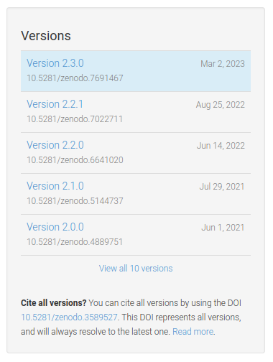
Consistent
(Execution)
Reproducible
Strict versioning
Use of container engines/software environments
$ nextflow run \ > nf-core/mag -r 2.3.0 <...>

Slide 26
For Users:
Summary
To summarise, nf-core provides:
Ready-to-go pipelines for many types of biological analyses
Community agreement
Extremely scalable analyses and portable
Efficient and fault tolerant
Well documented and supported

Slide 27











Selection of relevant nf-core pipelines for metagenomics
Ancient or modern with ancient metagenomics
Microbial metagenomics
related
Modern metagenomics
General utility

Slide 28
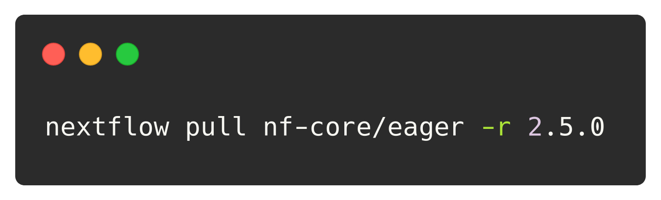
Installing nf-core pipelines
Any Nextflow pipeline on a web-based Git repository (GitHub, GitLab, etc.) can be downloaded with the pull command
Specify the user/pipeline name (on GitHub/GitLab etc.)
Specify the revision (version) of the pipeline
Notes:
nextflow pull nf-core/eager -r 2.5.0

Slide 29
Running and monitoring nf-core pipelines

Slide 30
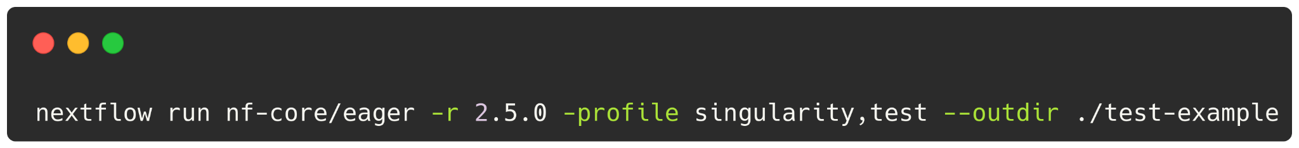
How to test an nf-core pipeline is working
Any installed Nextflow pipeline is CLI executed with the run command.
Here we will do an ‘unrealistic’ run with a test example configuration. Every nf-core pipeline has a test profile containing a small input dataset.
🚀 HIT IT! 🚀
Specify the pipeline location/name (either a local path or git repo)
Specify the revision (version) of the pipeline
A named configuration profile (single dash = core nextflow option)
A pipeline parameter (double dash = pipeline option)
Notes:
nextflow run nf-core/eager -r 2.5.0 -profile singularity,test --outdir ./test-example

Slide 31
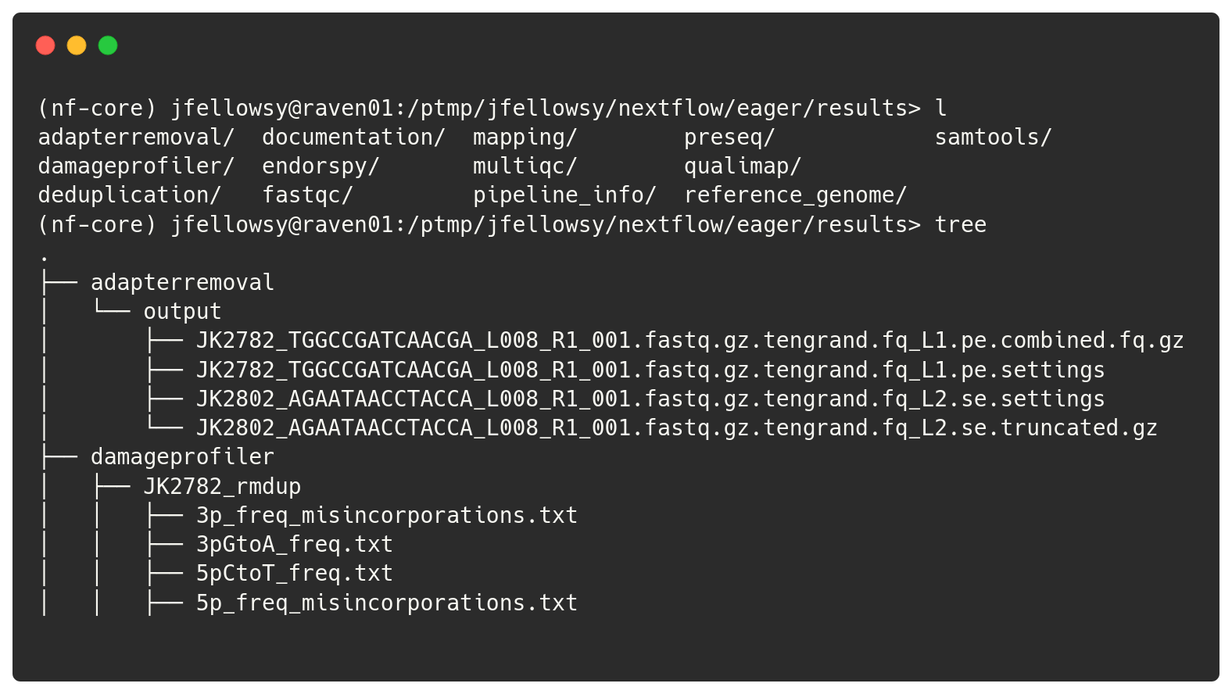
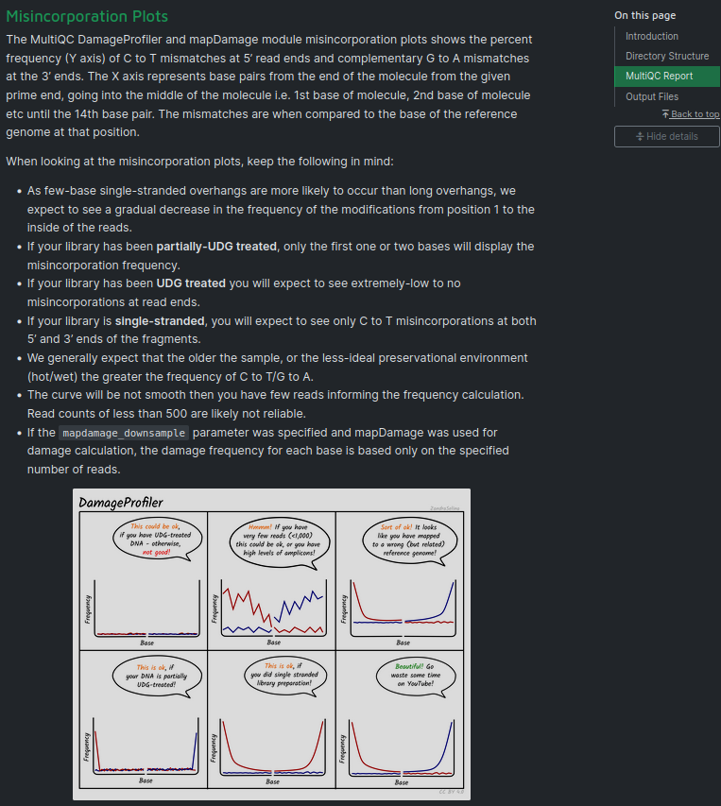
nf-core pipeline output
How to interpret? See the nf-core website!
See the contents of --outdir
See the contents of --outdir

Slide 32
A more realistic run command
The test profile uses pre-supplied data, thus is not the most realistic usage.
Most nf-core pipelines require the use of samplesheets to supply your own input data, and then a variety of parameters to turn on and off different steps.

Slide 33
A more realistic run command
Example csv input samplesheet for nf-core/eager
Sample_Name | Library_ID | Lane | Colour_Chemistry | SeqType | Organism | Strandedness | UDG_Treatment | R1 | R2 | BAM
2611 | ERR5766171 | 0 | 4 | PE | Homo sapiens | single | none | ERR5766171_1.fastq.gz | ERR5766171_2.fastq.gz | NA
2611 | ERR5766175 | 0 | 4 | PE | Homo sapiens | single | none | ERR5766175_1.fastq.gz | ERR5766175_2.fastq.gz | NA
2612 | ERR5766179 | 0 | 4 | PE | Homo sapiens | single | none | ERR5766179_1.fastq.gz | ERR5766179_2.fastq.gz | NA
2612 | ERR5766180 | 0 | 4 | PE | Homo sapiens | single | none | ERR5766180_1.fastq.gz | ERR5766180_2.fastq.gz | NA

Slide 34
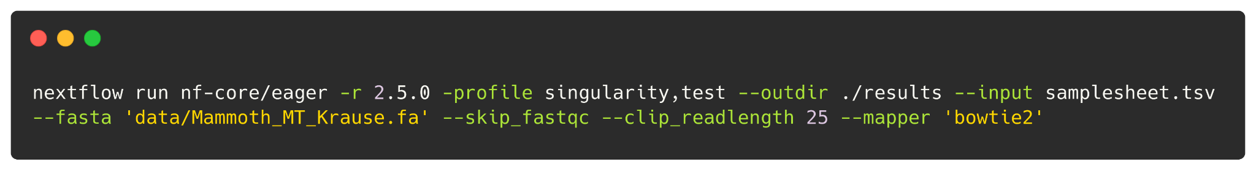
A more realistic run command
All pipeline parameters can be specified on the CLI.
⚠️ DO NOT RUN ⚠️
Path parameter
(best in quotes! Can also be URLs/S3!)
Boolean parameter (--param_name False for False)
Numeric parameter
String parameter

Slide 35

What about GUI execution?
If you’re not completely comfortable using command line interfaces (CLI), We have you covered for all nf-core pipelines on: https://nf-co.re !

Slide 36
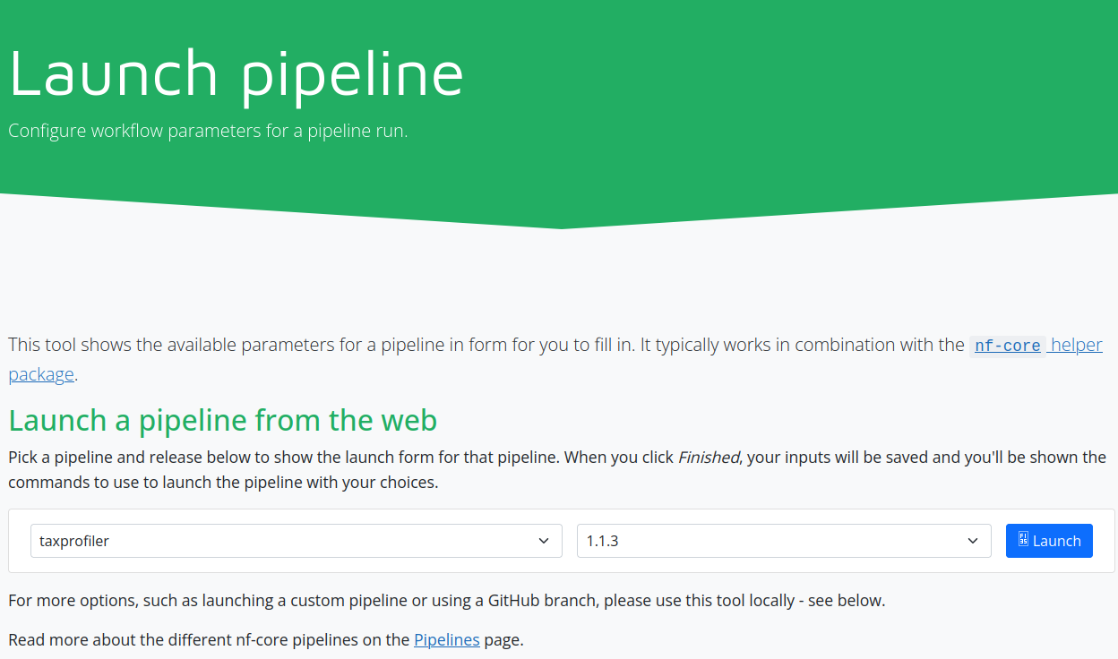
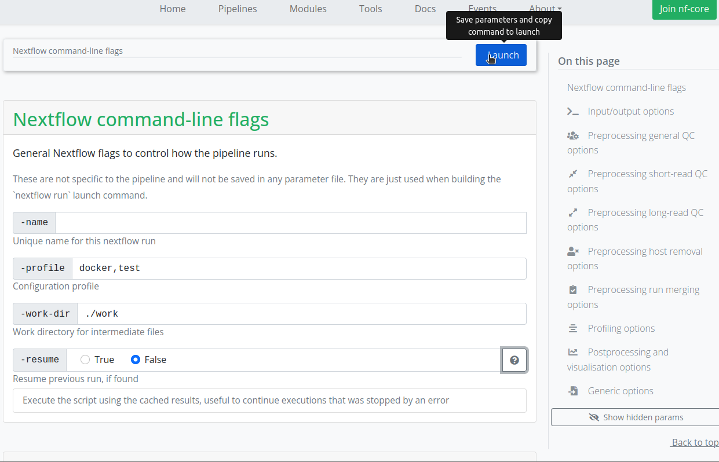
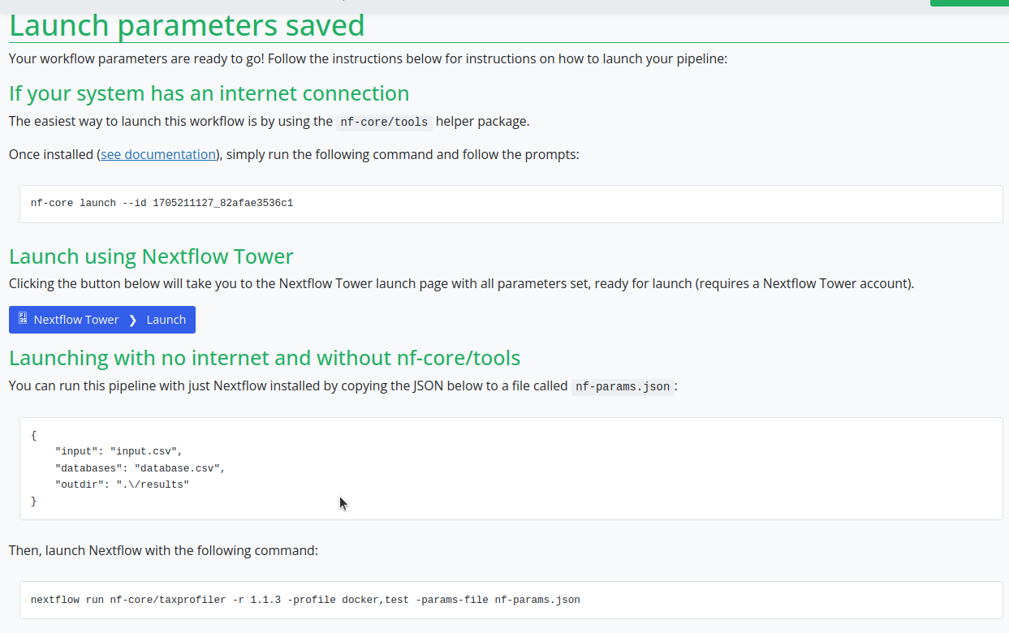
Using nf-core launch GUI

Slide 37
Configuring nf-core pipelines

Slide 38
Adapting execution to your infrastructure
To get the workflow manager to work most efficiently, we must tell the pipeline about the infrastructure it is running on. We do this with configs.
You can also use these configs to create a reusable ‘settings’ file, allowing you to re-run the pipeline on different datasets.

Slide 39
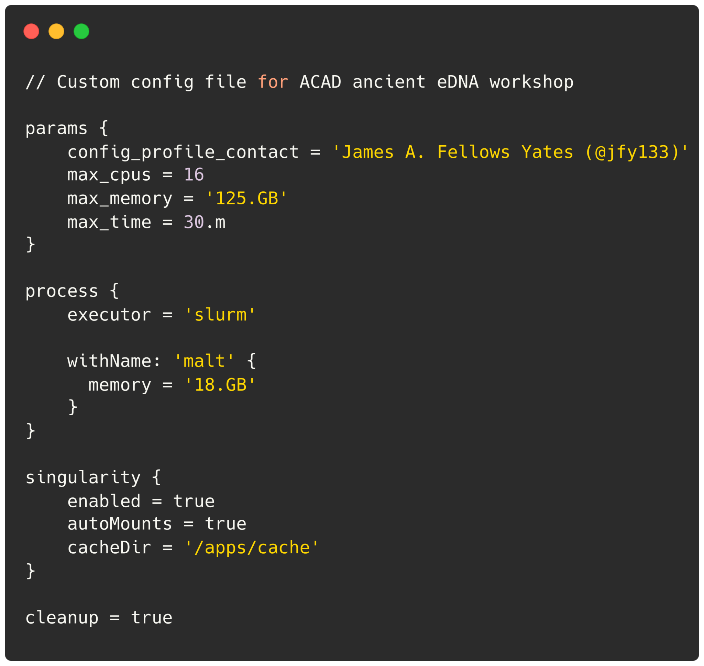
Configs for infrastructure
Specify how your machine or HPC cluster works
Computing resource maximums
Scheduler & queues
Job specific specifications
Software environment
Common resources

Slide 40
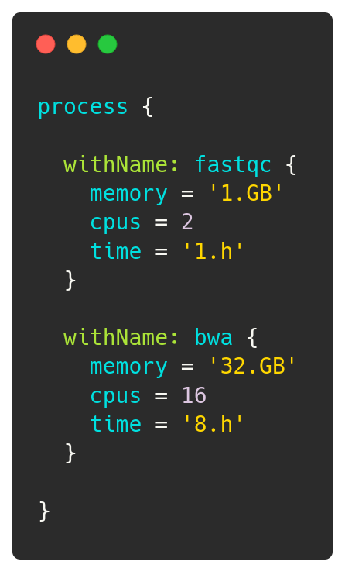
Configs for data
Optimise the run time and scheduler usage
Customise the resources used / requested of each independent process (a.k.a. step/job/task) of the pipeline run

Slide 41
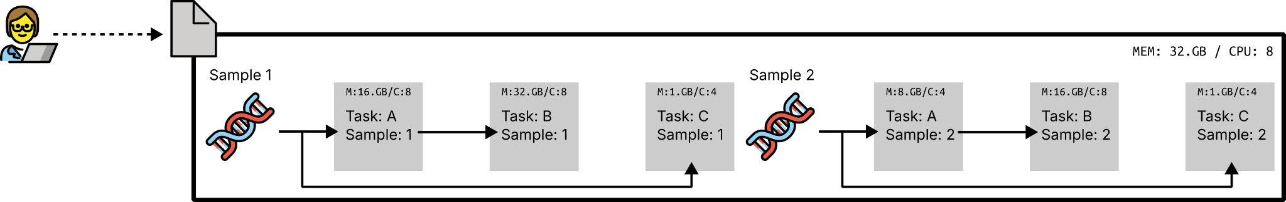

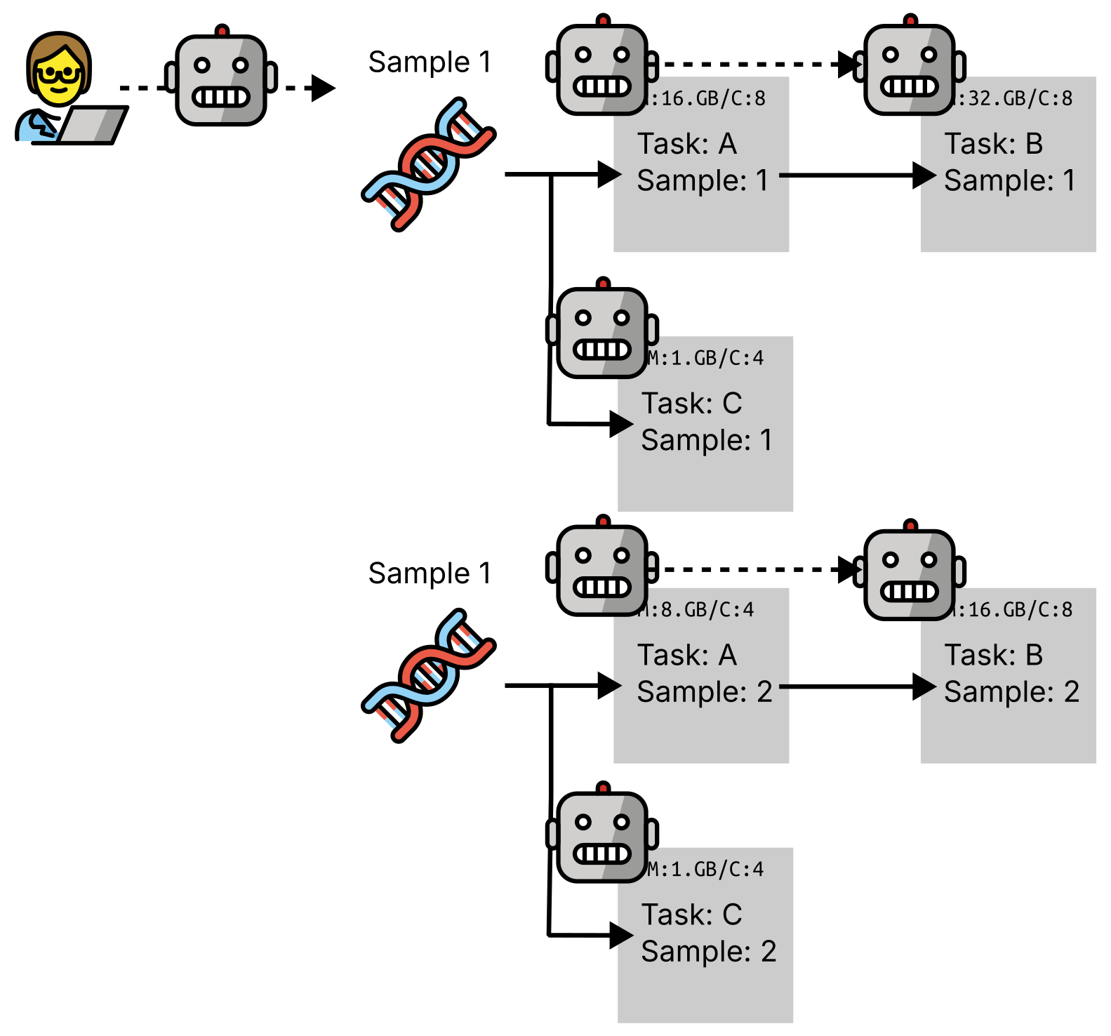

Reminder
All emojis designed by OpenMoji – the open-source emoji and icon project. License: CC BY-SA 4.0

Slide 42
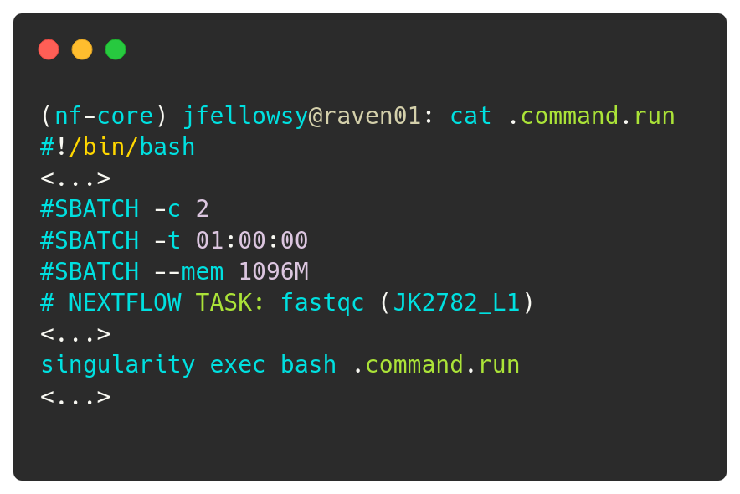
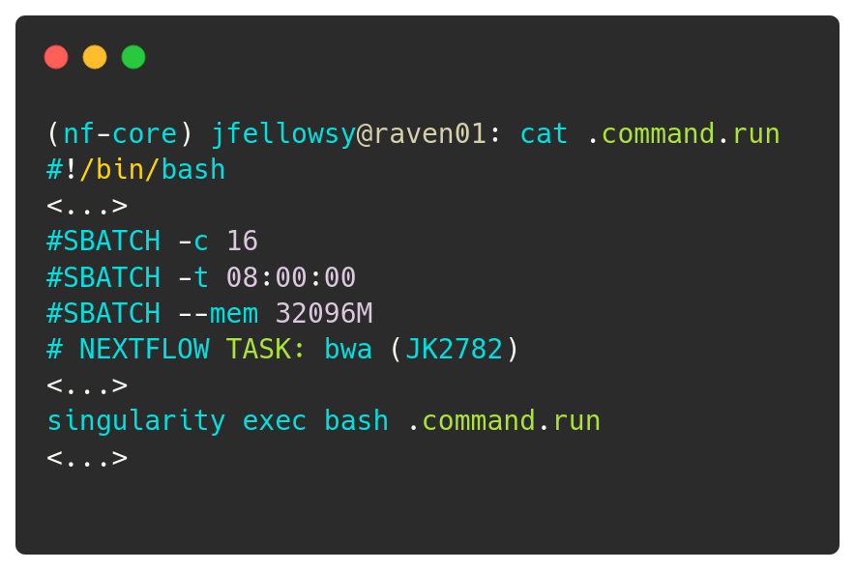
Configs for data
What you specify in a config file…
What Nextflow does under the hood

Slide 43
Sharing is caring!
Configure once, run all nf-core pipelines!

Slide 44
Debugging nf-core pipelines

Slide 45
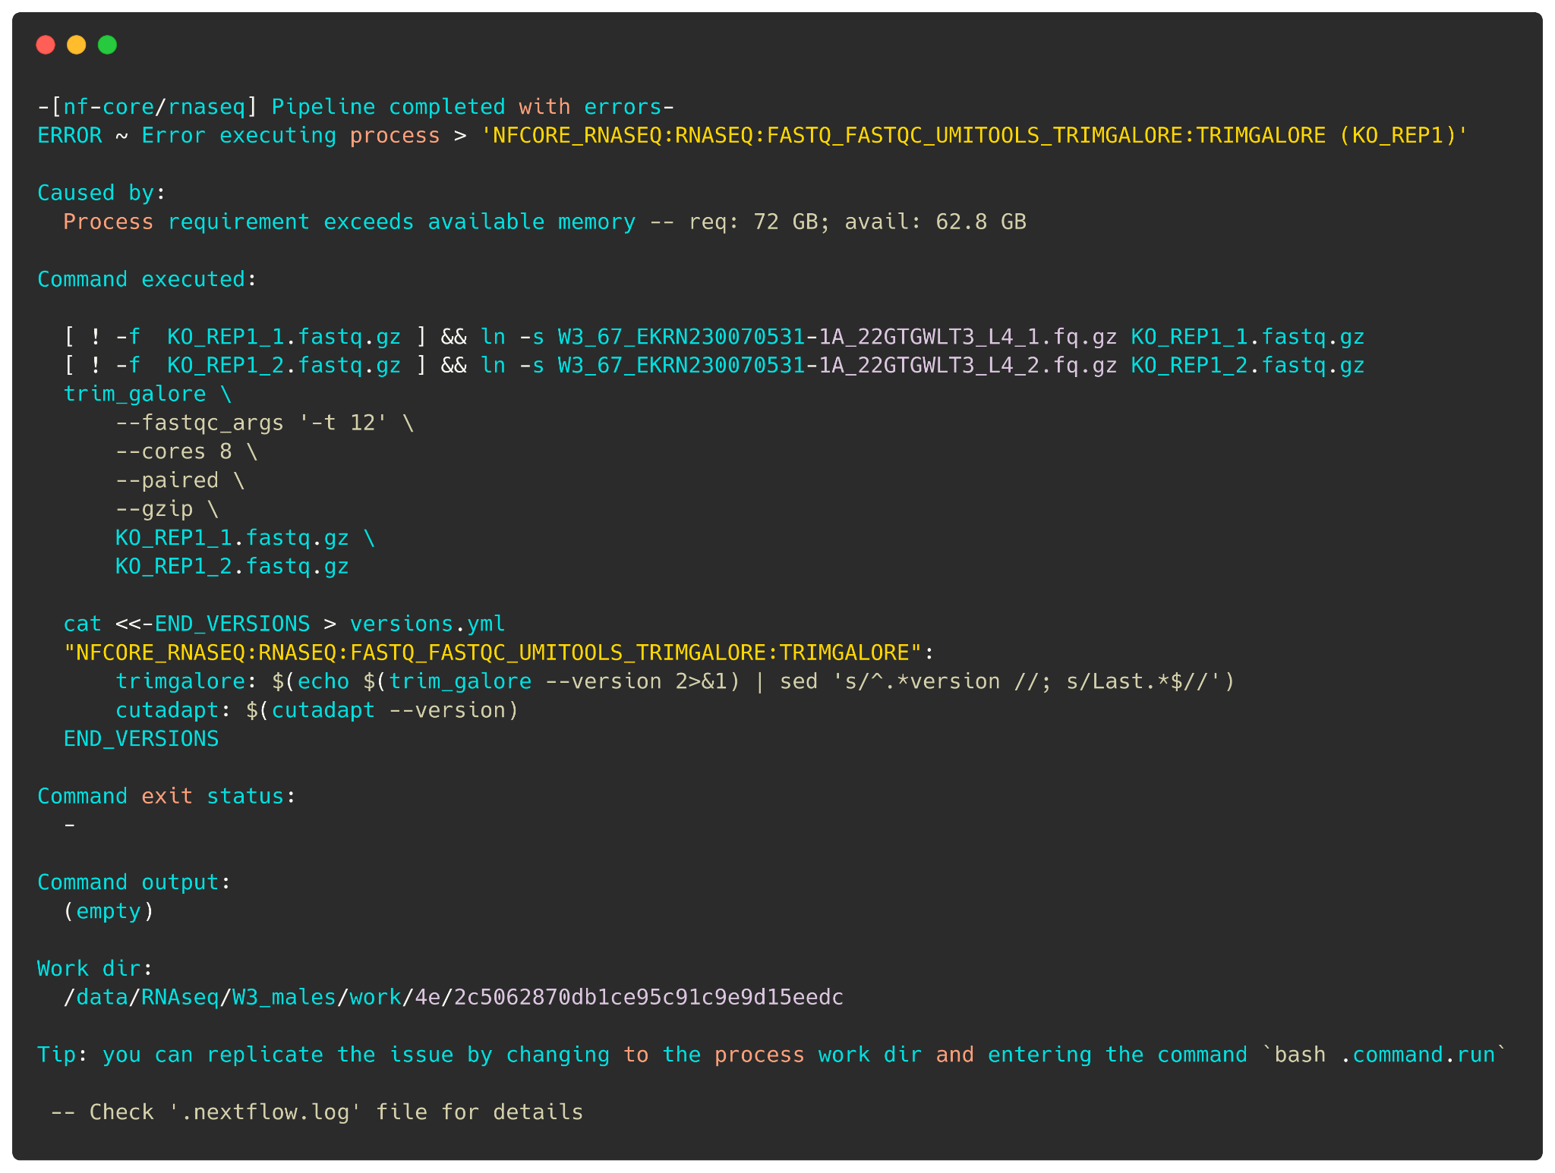
Read the error
message
A typical Nextflow error message can give you a lot of information.
Name of part (process) of the pipeline that failed
The Nextflow error message!
The bash exit code (google this if not 0 or 255!)
The command stdout (what the tool prints to console)
Path to where commands were being executed

Slide 46
Read the documentation
All nf-core pipelines come with 3 dedicated pages
Usage
Parameters
Output
These are online at https://nf-co.re/<pipelinename>
The nf-core website also has general documentation including troubleshooting at https://nf-co.re/docs

Slide 47
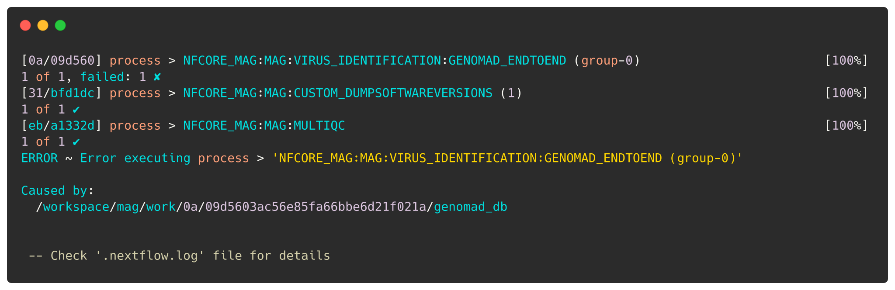
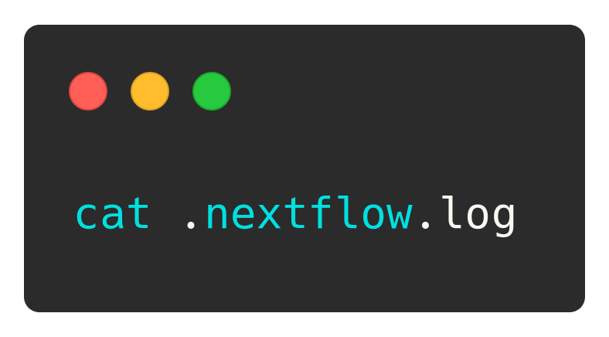
Read the log files
Everytime you execute nextflow run a (hidden!) .nextflow.log file in the location you ran the pipeline!
Pipeline run failed but no error? Inspect this file!
This can be overwhelming(!), but can often provide more information.
Notes:
Note: each new run in the same location renames old logs: the old .nextflow.log becomes .nextflow.log.1

Slide 48
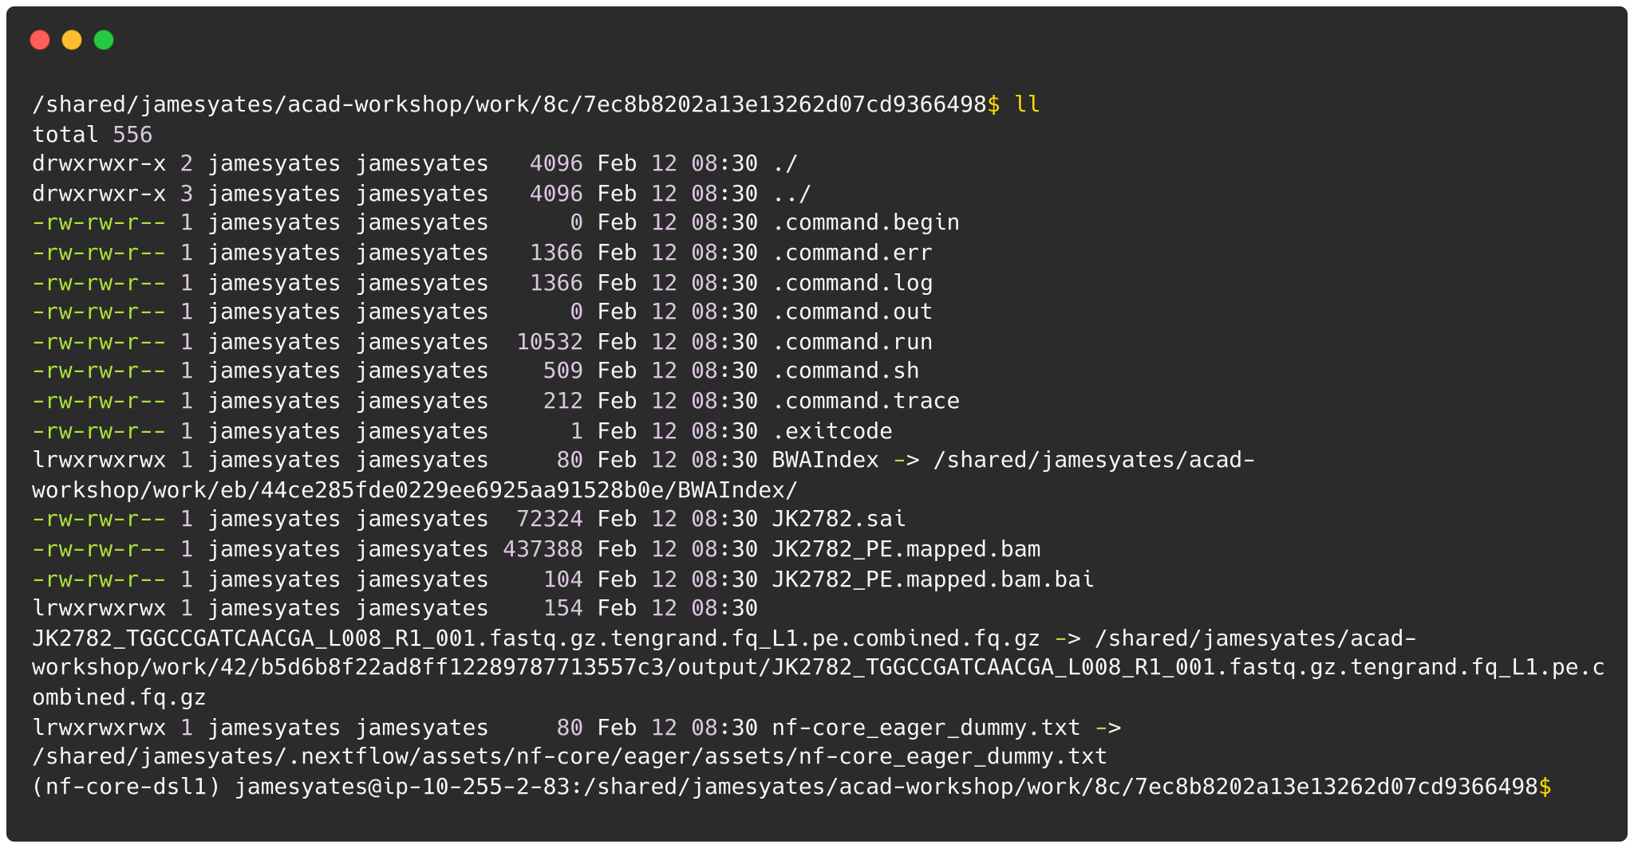
Inspecting a ‘working directory’
Remember that ‘hash’ at the beginning of each line of the console?
Represents the unique location of that task of the pipeline!
Inside has:
Input, intermediate files
Execution scripts (hidden!)
Software log files
Output files

Slide 49
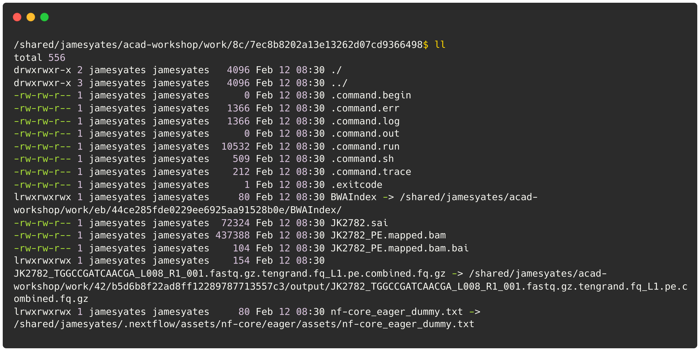
Inspecting a ‘working directory’
Exploring these files help understand how Nextflow works under the hood!
Ignore
STDERR of commands only
Combined STDOUT and STDERR of commands
STDOUT of commands only
The script submitted to the cluster
The script containing the command(s)
Ignore
The final bash exit code of the command
A symlinked input file
Output file
Try exploring a work directory yourself!
Notes:
.command.err: stderr console stream of the executed command
.command.log: combined stderr and
.command.out: stdout console stream of the executed command
.command.run: the actual bash or sbatch script executed
.command.sh: a bash script containing the generated tool command
.exitcode: file containing the exit code of the process (on completion)
test_sample2_R1.fastq.gz: a symlinked input file from a previous process
test_sample2_run0_raw_1_fastqc.html: output file
Try exploring one yourself now!

Slide 50
Report the error
Essential
Command you used
Version
Error message
Log files
Nice to have
Input samplesheet

Slide 51
Recap: Session Objectives
To learn
✅ What are and the benefits of workflow managers
✅ What is nf-core
✅ What is and how to install conda
✅ How to install and conda correctly
✅ How to install Nextflow
✅ How to run and monitor an nf-core pipeline
✅ How to configure an nf-core pipeline
✅ How to debug an nf-core pipeline

Slide 52

Next session
Applying our new running Nextflow pipeline skills to taxonomic classification and profiling nf-core pipeline nf-core/taxprofiler It allows for in-parallel taxonomic identification of reads or taxonomic abundance estimation with multiple classification and profiling tools against multiple databases

Slide 53
















More Info & Acknowledgements
https://nf-co.re
github.com/nf-core
nfcore.slack.com
youtube.com/nf-core
@nf_core@mstdn.science
@nf_core
Some emojis designed by OpenMoji – the open-source emoji and icon project. License: CC BY-SA 4.0
Financial &
Infrastructure Support:
HackMD
Speaker’s Support
Microbiome Sciences Group @
nf-core/core & community

